Slide 1
Emerging Technologies for the Circular Economy
Lecture 3: Lifecycle Assessment (LCA)
Prof. Dr. Benjamin Leiding
M.Sc. Anant Sujatanagarjuna
M.Sc. Shohreh Kia

Slide 2
License
This work is licensed under a Creative Commons Attribution-ShareAlike 4.0 International License. To view a copy of this license, please refer to https://creativecommons.org/licenses/by-sa/4.0/ .
Updated versions of these slides will be available in our Github repository.

Slide 3
Introduction

Slide 4

LCA – Motivation
Benjamin Leiding – CC BY-SA 4.0.

Slide 5
LCA – Motivation
Battery Electric Vehicles (EV)
Or
Internal Combustion Engine Vehicles
Benjamin Leiding – CC BY-SA 4.0.

Slide 6
EV Break-Even Point?
0 – 50.000km
50.000 – 100.000km
100.000 – 150.000km
150.000 – 200.000km
After 200.000km
What is the break-even point (in km) after which an EV would have caused fewer emissions than an Internal Combustion Engine (ICE?)

Slide 7
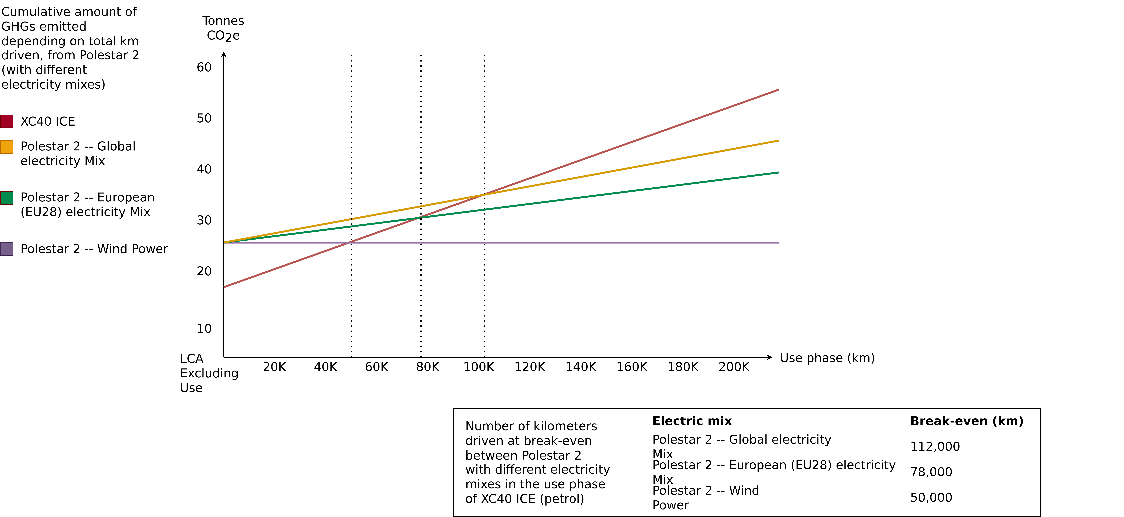
Life Cycle Assessment – Polestar 2
Polestar (2020) – Life Cycle Assessment – Carbon Footprint of Polestar 2.

Slide 8
Lifecycle Assessment (LCA)

Slide 9
Lifecycle Assessment (LCA)
Definition
“LCA addresses the environmental aspects and potential environmental impacts (e.g. use of resources and environmental consequences of releases) throughout a product’s lifecycle from raw material acquisition through production, use, end-of-life treatment, recycling and final disposal (i.e., cradle-to-grave).” -- ISO 14040
ISO 14040 Environmental management — Life cycle assessment — Principles and framework, International standards organisation (https://www.iso.org/standard/37456.html)

Slide 10
Lifecycle Assessment (LCA)
ISO 14040 & ISO 14044
The ISO 14040/14044 (ISO14040, 2006) (ISO14044, 2006) together provide a loose methodology for conducting LCA studies.
ISO 14040 defines the principles and framework of the standard
ISO 14044 provides requirements and guidelines for LCA practitioners.
Their scope is very broad, hence requiring LCA practitioners to further refine the methodology for their specific needs.
More info on points, percentages, etc. follow on the next slides (Examination)
ISO 14040 Environmental management — Life cycle assessment — Principles and framework, International standards organisation (https://www.iso.org/standard/37456.html)
ISO 14044 Environmental management — Life cycle assessment — Requirements and guidelines, International standards organisation (https://www.iso.org/standard/38498.html)

Slide 11
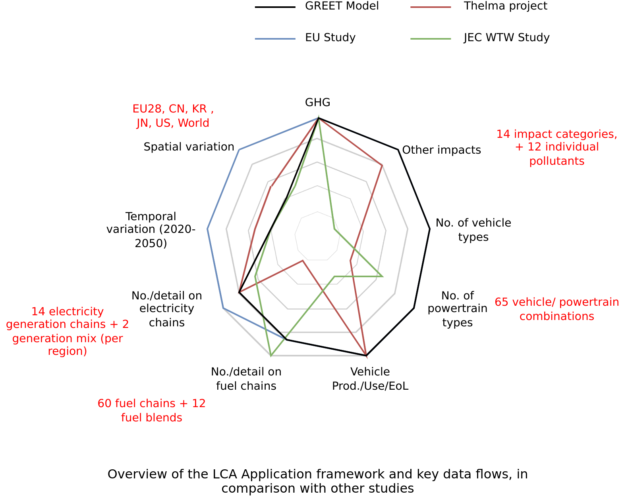
Lifecycle Assessment (LCA)
2020 EU Commission Report
“Determining the environmental impacts of conventional and alternatively fuelled vehicles through LCA”
Prepared by Ricardo Energy and Environment
Generally follows the ISO 14040 and ISO 14044 standards.
More info on points, percentages, etc. follow on the next slides (Examination)
Image adapted from Determining the environmental impacts of conventional and alternatively fuelled vehicles through LCA, Ricardo Energy and Environment (Link)

Slide 12
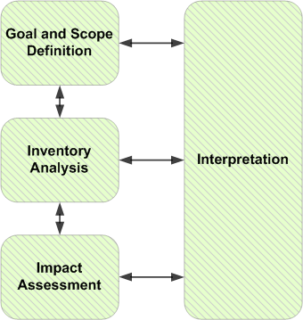
Lifecycle Assessment (LCA)
The four main stages
LCI
LCIA
Mr3641 – https://commons.wikimedia.org/wiki/File:PhasesOfLifeCycleAnalysis.png – CC BY-SA 4.0.

Slide 13
Goal and scope definition

Slide 14
Goal and Scope Definition
Goal of an LCA study
ISO 14040 definition
The goal of an LCA states:
The intended application
The reasons for carrying out the study
The intended audience
Whether the results are intended to be used in comparitive assertions released publicly
ISO 14040 Environmental management — Life cycle assessment — Principles and framework, International standards organisation (https://www.iso.org/standard/37456.html)
Determining the environmental impacts of conventional and alternatively fuelled vehicles through LCA, Ricardo Energy and Environment (Link)

Slide 15
Goal and Scope Definition
Goal of an LCA study
2020 EU Study:
The intended application: A representative selection of road vehicle configurations.
Aims to enhance the Commission's understanding of environmental impacts and of suitable methodologies to assess them in the mid- to long-term time frame (until 2050).
Target audience: European Commission and decision-makers.
ISO 14040 Environmental management — Life cycle assessment — Principles and framework, International standards organisation (https://www.iso.org/standard/37456.html)
Determining the environmental impacts of conventional and alternatively fuelled vehicles through LCA, Ricardo Energy and Environment (Link)

Slide 16
Goal and Scope Definition
Scope of an LCA study
ISO 14040 standard
The scope of an LCA should describe:
The functional unit(s) of the system(s)
Reference flow(s)
The system boundary
LCIA methodology and types of impacts analysed
Limitations
Data quality requirements
...
ISO 14040 Environmental management — Life cycle assessment — Principles and framework, International standards organisation (https://www.iso.org/standard/37456.html)

Slide 17
Goal and Scope Definition
Scope of an LCA study
ISO 14040 standard
The scope of an LCA should describe:
The functional unit(s) of the system(s)
Reference flow(s)
The system boundary
LCIA methodology and types of impacts analysed
Limitations
Data quality requirements
...
quantified performance of a product system for use as a reference unit, e.g 1 million holes drilled
ISO 14040 Environmental management — Life cycle assessment — Principles and framework, International standards organisation (https://www.iso.org/standard/37456.html)

Slide 18
Goal and Scope Definition
Scope of an LCA study
ISO 14040 standard
The scope of an LCA should describe:
The functional unit(s) of the system(s)
Reference flow(s)
The system boundary
LCIA methodology and types of impacts analysed
Limitations
Data quality requirements
...
quantified performance of a product system for use as a reference unit, e.g 1 million holes drilled
measure of the outputs from processes in a given product system required to deliver the performace defined by
the functional unit
ISO 14040 Environmental management — Life cycle assessment — Principles and framework, International standards organisation (https://www.iso.org/standard/37456.html)

Slide 19
Goal and Scope Definition
Scope of an LCA study
ISO 14040 standard
The scope of an LCA should describe:
The functional unit(s) of the system(s)
Reference flow(s)
The system boundary
LCIA methodology and types of impacts analysed
Limitations
Data quality requirements
...
quantified performance of a product system for use as a reference unit, e.g 1 million holes drilled
measure of the product(s) or product parts required to deliver the performance defined by the functional unit.
ISO 14040 Environmental management — Life cycle assessment — Principles and framework, International standards organisation (https://www.iso.org/standard/37456.html)

Slide 20
Goal and Scope Definition
Scope of an LCA study
ISO 14040 standard
The scope of an LCA should describe:
The functional unit(s) of the system(s)
Reference flow(s)
The system boundary
LCIA methodology and types of impacts analysed
Limitations
Data quality requirements
…
2020 EU Study
Functional units and reference flows
Based on vehicle size and utility
Body Type | Passenger Car | Van | Rigid Lorry | Artic Lorry | Urban bus | Coach
Default reference flow | Vehicle-km (vkm) | Vehicle-km (vkm) | Tonne-km (tkm) | Tonne-km (tkm) | Vehicle-km (vkm) | Vehicle-km (vkm)
ISO 14040 Environmental management — Life cycle assessment — Principles and framework, International standards organisation (https://www.iso.org/standard/37456.html)
Determining the environmental impacts of conventional and alternatively fuelled vehicles through LCA, Ricardo Energy and Environment (Link)

Slide 21
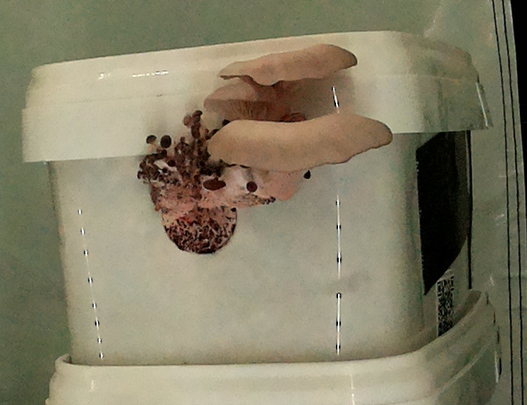
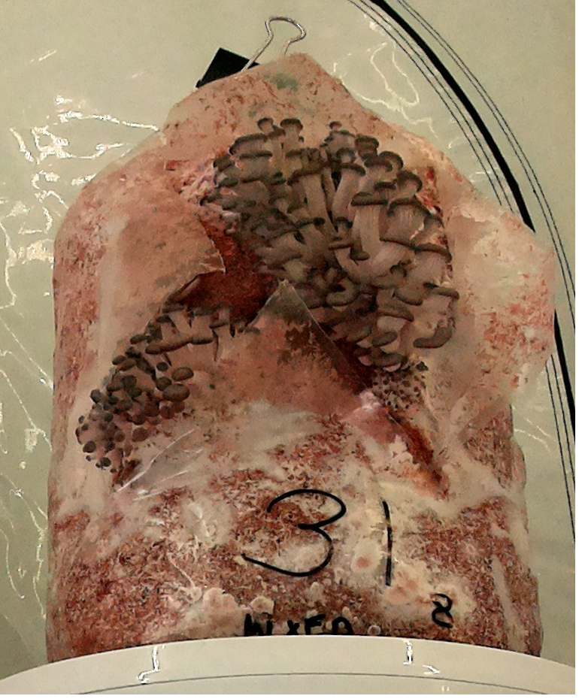
MushR: A Short Detour
Mushroom production
Substrate:
The medium from which the mushrooms grow.
MushR – A Smart, Automated and Scalable Indoor Harvesting System for Gourmet Mushrooms – etce-lab.com
Anant Sujatanagarjuna, Benjamin Leiding, Harish Gundelli, Shohreh Kia – CC BY-SA 4.0.

Slide 22
MushR: A Short Detour
Mushroom production
Substrate:
The medium from which the mushrooms grow.
Substrate Container:
Contains the substrate throughout the entirity of the substrate’s “lifespan”.
After innoculation:
Small ventilation holes (filtered) that fascilitate incubation.
MushR – A Smart, Automated and Scalable Indoor Harvesting System for Gourmet Mushrooms – etce-lab.com
Anant Sujatanagarjuna, Benjamin Leiding, Harish Gundelli, Shohreh Kia – CC BY-SA 4.0.

Slide 23
MushR: A Short Detour
Mushroom production
Substrate:
The medium from which the mushrooms grow.
Substrate Container:
Contains the substrate throughout the entirity of the substrate’s “lifespan”.
After innoculation:
Small ventilation holes (filtered) that fascilitate incubation.
After incubation period:
Fruiting holes are opened.
Contained substrate is exposed to fresh air and high humidity allowing mushrooms to grow through the holes.
MushR – A Smart, Automated and Scalable Indoor Harvesting System for Gourmet Mushrooms – etce-lab.com
Anant Sujatanagarjuna, Benjamin Leiding, Harish Gundelli, Shohreh Kia – CC BY-SA 4.0.

Slide 24
MushR: A Short Detour
Mushroom production
Substrate:
The medium from which the mushrooms grow.
Substrate Container:
Contains the substrate throughout the entirity of the substrate’s “lifespan”.
After innoculation:
Small ventilation holes (filtered) that fascilitate incubation.
After incubation period:
Fruiting holes are opened.
Contained substrate is exposed to fresh air and high humidity allowing mushrooms to grow through the holes.
After some fruiting cycles:
Substrate is discarded/composted.
MushR – A Smart, Automated and Scalable Indoor Harvesting System for Gourmet Mushrooms – etce-lab.com
Anant Sujatanagarjuna, Benjamin Leiding, Harish Gundelli, Shohreh Kia – CC BY-SA 4.0.

Slide 25
MushR: A Short Detour
Mushroom Substrate Containers
Traditional Substrate Containers:
Plastic (polypropylene) bags
Usually sealed by folding the opening several times, then sealing it with tape/clips.
Can be tricky to seal.
Need to be re-opened for innoculation.
MushR – A Smart, Automated and Scalable Indoor Harvesting System for Gourmet Mushrooms – etce-lab.com
Anant Sujatanagarjuna, Benjamin Leiding, Harish Gundelli, Shohreh Kia – CC BY-SA 4.0.

Slide 26
MushR: A Short Detour
Mushroom Substrate Containers
Traditional Substrate Containers:
Plastic (polypropylene) bags
Usually sealed by folding the opening several times, then sealing it with tape/clips.
Can be tricky to seal.
Need to be re-opened for innoculation.
Fruiting holes are permanent; basically made by cutting through the bags → Cannot be reused
Single-use only.
MushR – A Smart, Automated and Scalable Indoor Harvesting System for Gourmet Mushrooms – etce-lab.com
Anant Sujatanagarjuna, Benjamin Leiding, Harish Gundelli, Shohreh Kia – CC BY-SA 4.0.

Slide 27
MushR: A Short Detour
Mushroom Substrate Containers
MushR Substrate Pods:
Plastic (polypropylene) buckets.
Sealed by a plastic lid.
Trivial to seal/unseal.
Fruiting holes are still permanent; drilled into the bucket
Sealed with micro-porous tape during incubation.
Tape is removed for fruiting mushrooms → Can be reused.
MushR – A Smart, Automated and Scalable Indoor Harvesting System for Gourmet Mushrooms – etce-lab.com
Anant Sujatanagarjuna, Benjamin Leiding, Harish Gundelli, Shohreh Kia – CC BY-SA 4.0.

Slide 28
MushR: A Short Detour
Mushroom Substrate Containers
MushR Substrate Pods:
Plastic (polypropylene) buckets.
Sealed by a plastic lid.
Trivial to seal/unseal.
Fruiting holes are still permanent; drilled into the bucket
Sealed with micro-porous tape during incubation.
Tape is removed for fruiting mushrooms → Can be reused.
But:
Higher resource consumption required for production.
More complicated manufacturing process.
MushR – A Smart, Automated and Scalable Indoor Harvesting System for Gourmet Mushrooms – etce-lab.com
Anant Sujatanagarjuna, Benjamin Leiding, Harish Gundelli, Shohreh Kia – CC BY-SA 4.0.

Slide 29
MushR: A Short Detour
LCA on Substrate Containers?
Goal
Compare the environmental impact of the developed mushroom pods with non-reusable substrate bags by running lifecycle assessment calculations.
MushR – A Smart, Automated and Scalable Indoor Harvesting System for Gourmet Mushrooms – etce-lab.com
Anant Sujatanagarjuna, Benjamin Leiding, Harish Gundelli, Shohreh Kia – CC BY-SA 4.0.

Slide 30
Goal and Scope Definition
Functional Unit VS Reference Flow
Functional Unit
Reference Flow
quantified performance of a product system for use as a reference unit, e.g 1 million holes drilled
a measure of the product(s) or product parts required to deliver the performance defined by the functional unit.
How can you define the functional unit for a mushroom substrate container?

Slide 31
Goal and Scope Definition
Functional Unit VS Reference Flow
Functional Unit
Reference Flow
quantified performance of a product system for use as a reference unit, e.g 1 million holes drilled
a measure of the product(s) or product parts required to deliver the performance defined by the functional unit.
How can you define the functional unit for a mushroom substrate container?
In terms of “Colonizable volume of the container”: 3L colonizable volume

Slide 32
Goal and Scope Definition
Functional Unit VS Reference Flow
Functional Unit
Reference Flow
quantified performance of a product system for use as a reference unit, e.g 1 million holes drilled
a measure of the product(s) or product parts required to deliver the performance defined by the functional unit.
How can you define the functional unit for a mushroom substrate container?
In terms of “Colonizable volume of the container”: 3L colonizable volume
How can you define the reference flow?

Slide 33
Goal and Scope Definition
Functional Unit VS Reference Flow
Functional Unit
Reference Flow
quantified performance of a product system for use as a reference unit, e.g 1 million holes drilled
a measure of the product(s) or product parts required to deliver the performance defined by the functional unit.
How can you define the functional unit for a mushroom substrate container?
In terms of “Colonizable volume of the container”: 3L colonizable volume
How can you define the reference flow?
In terms of the “Amount of polypropylene (g)” (weight of the container)

Slide 34
Goal and Scope Definition
Scope of an LCA study
ISO 14040 definition
The scope of an LCA should describe:
The functional units of the system(s)
Reference Flows
The system boundary
LCIA methodology and types of impacts analysed
Limitations
Data quality requirements
...
determines which processes are included in the LCA in accordance with it’s goal
ISO 14040 Environmental management — Life cycle assessment — Principles and framework, International standards organisation (https://www.iso.org/standard/37456.html)
Image recreated from Determining the environmental impacts of conventional and alternatively fuelled vehicles through LCA, Ricardo Energy and Environment (Link)

Slide 35
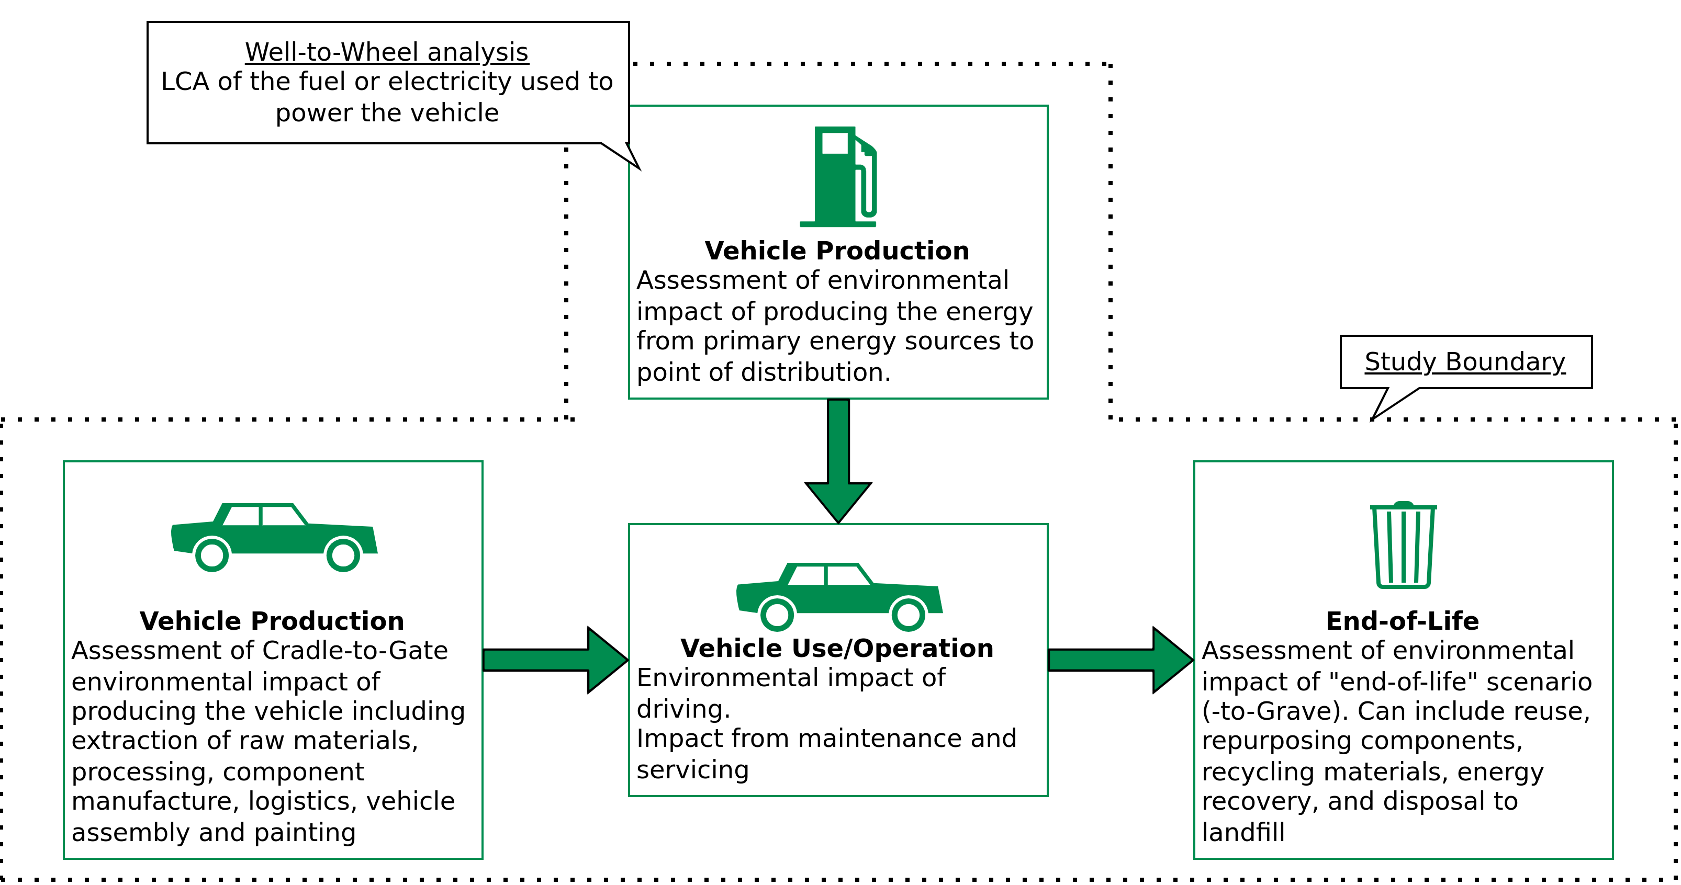
Goal and Scope Definition
System Boundary of 2020 EU Study
ISO 14040 Environmental management — Life cycle assessment — Principles and framework, International standards organisation (https://www.iso.org/standard/37456.html)
Image recreated from Determining the environmental impacts of conventional and alternatively fuelled vehicles through LCA, Ricardo Energy and Environment (Link)

Slide 36
Goal and Scope Definition
Scope of an LCA study
ISO 14040 definition
The scope of an LCA should describe:
The functional units of the system(s)
Reference Flows
The system boundary
LCIA methodology and types of impacts analysed
Limitations
Data quality requirements
...
MushR reusable mushroom pods
(Theoretical) Manufacturing process
(Theoretical) End-of-life recycling process
ISO 14040 Environmental management — Life cycle assessment — Principles and framework, International standards organisation (https://www.iso.org/standard/37456.html)

Slide 37
Goal and Scope Definition
Quantitative definition of system boundaries – the Cut-off criteria
In general, all processes and flows that are attributable to the analysed system are to be included in the system boundaries.
However, not all of them are quantitatively “relevant”.
For less relevant ones, data of lower quality (estimates) can be used, limiting the effort for collecting high quality data.
Irrelevant ones, can be entirely “Cut-off”
ILCD Handbook – General guide for Life Cycle Assessment – Detailed Guidance (Link)

Slide 38
Goal and Scope Definition
Quantitative definition of system boundaries – the Cut-off criteria
“Cut-off” refers to the omission of not relevant life cycle stages, activity types (e.g. investment goods, storage, …), specific processes and products and elementary flows from the system model.
Cut-offs are quantified in relation to the percentage of environmental impacts that is approximated to be excluded via the cut-off.
e.g., "95 %" relates to cutting off about 5 % of the total environmental impact (or of a selected impact category)
ILCD Handbook – General guide for Life Cycle Assessment – Detailed Guidance (Link)

Slide 39
Goal and Scope Definition
Quantitative definition of system boundaries – the Cut-off criteria
“Cut-off” refers to the omission of not relevant life cycle stages, activity types (e.g. investment goods, storage, …), specific processes and products and elementary flows from the system model.
Cut-offs are quantified in relation to the percentage of environmental impacts that is approximated to be excluded via the cut-off.
e.g., "95 %" relates to cutting off about 5 % of the total environmental impact (or of a selected impact category)
BUT, this would require an approximation of 100% of the impact, because if we already knew what 100% impact is, we wouldn’t be doing the study anyway.
IMPORTANT: Cut-off should not be so big, or you can risk having incomplete data (meaning lower environmental impacts) and also overall uncertainity.
ILCD Handbook – General guide for Life Cycle Assessment – Detailed Guidance (Link)

Slide 40
2020 EU Study
Goal and Scope Definition
Scope of an LCA study
ISO 14040 definition
The scope of an LCA should describe:
The functional units of the system(s)
Reference flows
The system boundary
LCIA methodology and types of impacts analysed
Limitations
Data quality requirements
...
Impact Category | Indicator and unit
Climate change | Greenhouse gas emissions GWP100 in CO2 eq (including carbon feedbacks)
Energy consumption | Cumulative energy demand in MJ: non-renewable (fossil and nuclear) and renewable
Acidification | Acidification potential in SO2 eq
Eutrophication | Eutrophication potential in PO4³⁻ eq
Photochemical ozone formation | Photochemical Ozone Creation Potential POCP in NMVOC eq
Ozone depletion | ODP in R11 eq
Ionising radiation | Ionising radiation potentials in U235 eq
Particulate matter | Particulate matter formation in PM2.5 eq
Human toxicity, cancer and non-cancer | Comparative Toxic Unit for Human Health in CTUh
Ecotoxicity, freshwater | Comparative Toxic Unit for ecosystems in CTUe
Resource depletion – minerals and metals | ADP ultimate reserves in Sb eq
Resource depletion – fossil energy carriers | ADP fossil in MJ
Land use | Land occupation in m² * a
Water scarcity | Scarcity-adjusted water use in m³
ISO 14040 Environmental management — Life cycle assessment — Principles and framework, International standards organisation (https://www.iso.org/standard/37456.html)
Table recreated from Determining the environmental impacts of conventional and alternatively fuelled vehicles through LCA, Ricardo Energy and Environment (Link)

Slide 41
Goal and Scope Definition
Scope of an LCA study
ISO 14040 definition
The scope of an LCA should describe:
The functional units of the system(s)
Reference flows
The system boundary
LCIA methodology and types of impacts analysed
Limitations
Data quality requirements
...
MushR reusable mushroom pods
Limitations
No data calculations on the performance of the substrate container
Amount of mushrooms harvested?
Contaimination rate?
Generic manufacturing and recycling data
ISO 14040 Environmental management — Life cycle assessment — Principles and framework, International standards organisation (https://www.iso.org/standard/37456.html)

Slide 42
Lifecycle Inventory Analysis (LCI)

Slide 43
Lifecycle Inventory Analysis (LCI)
Definitions
LCI is the phase of lifecycle assessment involving the compilation and quantification of inputs and outputs for a product throughout it’s lifecycle.
ISO 14040 Environmental management — Life cycle assessment — Principles and framework, International standards organisation (https://www.iso.org/standard/37456.html)

Slide 44
Lifecycle Inventory Analysis (LCI)
Definitions
LCI is the phase of lifecycle assessment involving the compilation and quantification of inputs and outputs for a product throughout it’s lifecycle.
Inputs and outputs are product, material or energy flows that enter or leave a unit process.
ISO 14040 Environmental management — Life cycle assessment — Principles and framework, International standards organisation (https://www.iso.org/standard/37456.html)

Slide 45
Lifecycle Inventory Analysis (LCI)
Definitions
LCI is the phase of lifecycle assessment involving the compilation and quantification of inputs and outputs for a product throughout it’s lifecycle.
Inputs and outputs are product, material or energy flows that enter or leave a unit process.
A Unit Process is the smallest element considered in the life-cycle inventory analyis for which input and output data are quantified.
ISO 14040 Environmental management — Life cycle assessment — Principles and framework, International standards organisation (https://www.iso.org/standard/37456.html)

Slide 46
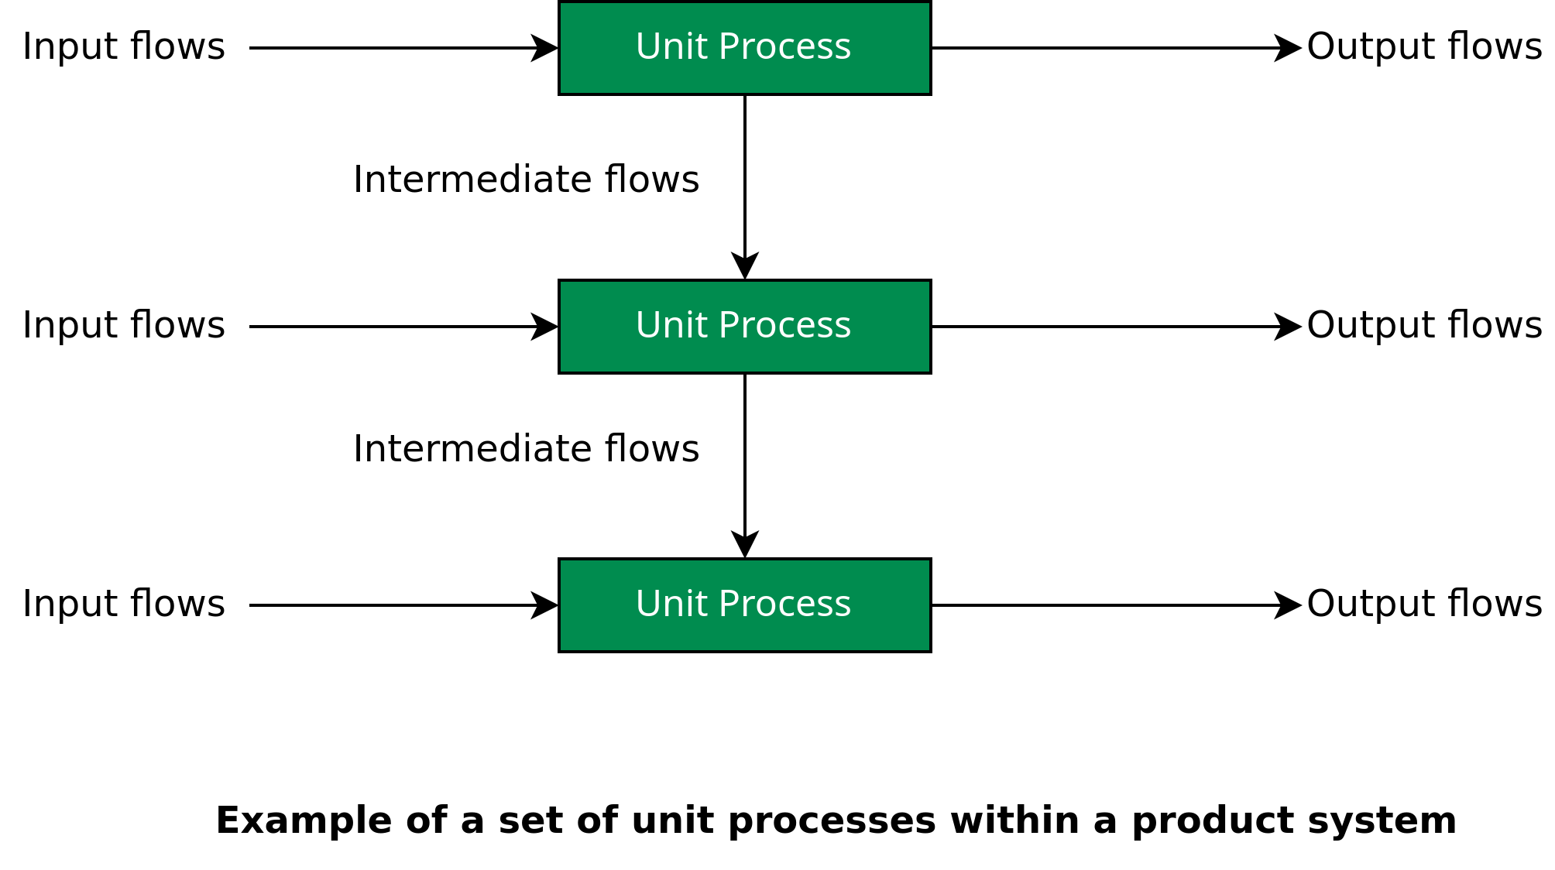
Lifecycle Inventory Analysis (LCI)
Images recreated from ISO 14040 Environmental management — Life cycle assessment — Principles and framework, International standards organisation (https://www.iso.org/standard/37456.html)

Slide 47
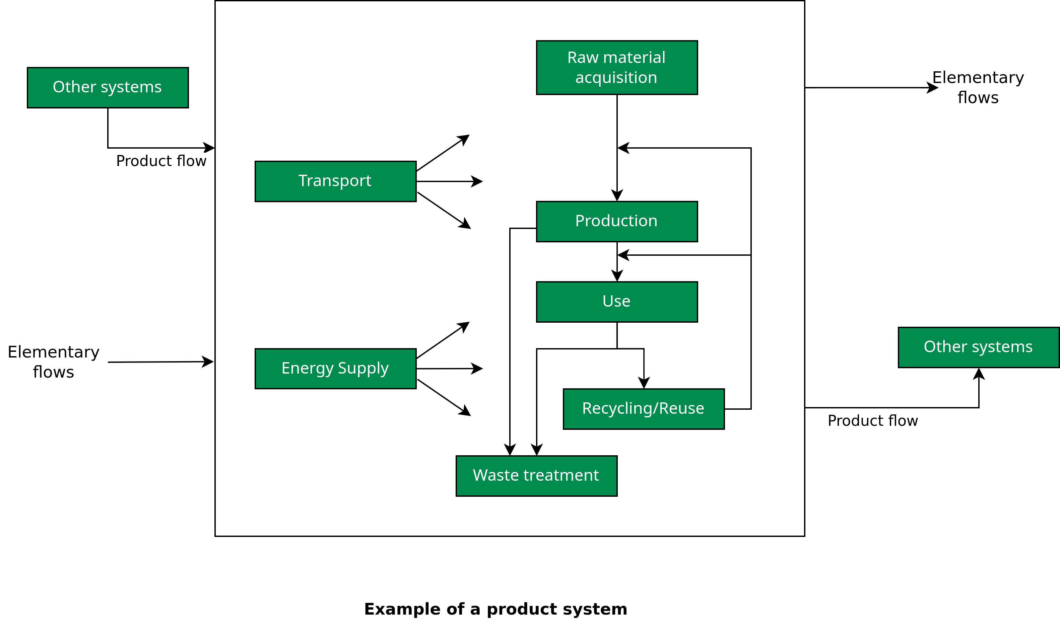
Lifecycle Inventory Analysis (LCI)
Images recreated from ISO 14040 Environmental management — Life cycle assessment — Principles and framework, International standards organisation (https://www.iso.org/standard/37456.html)

Slide 48
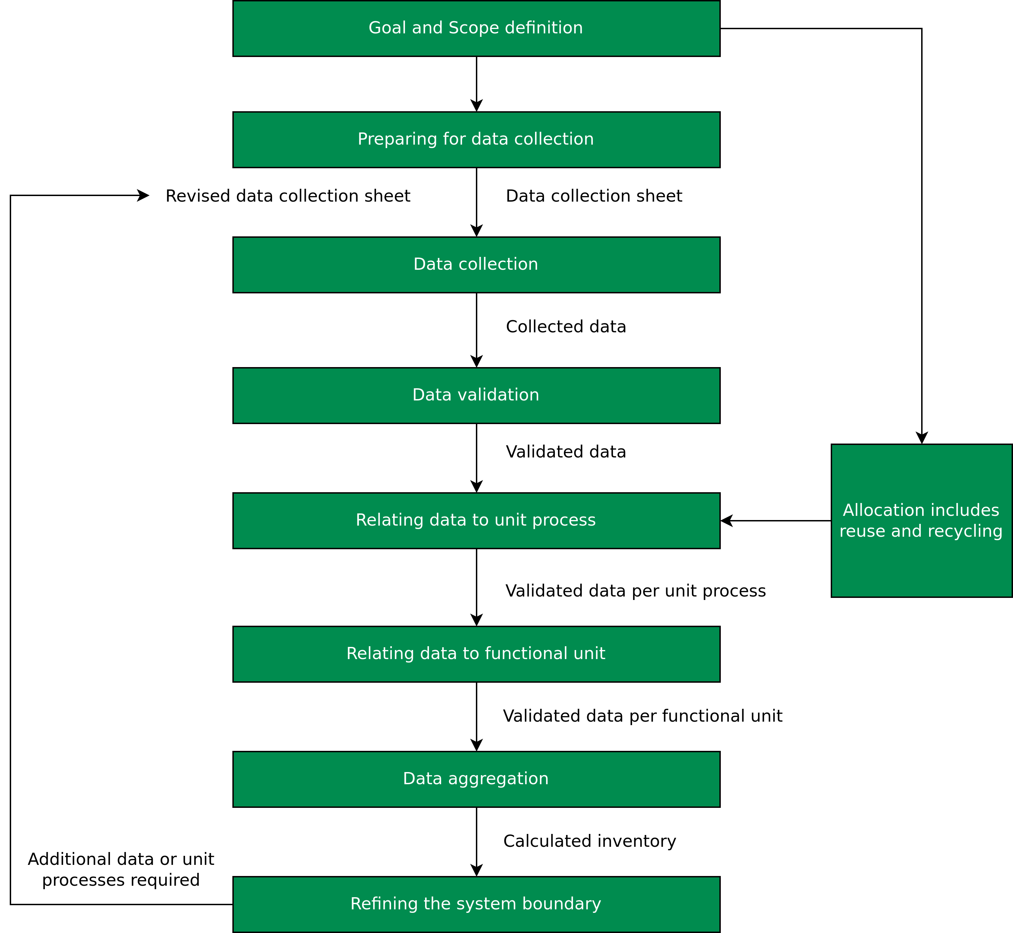
Lifecycle Inventory Analysis (LCI)
Preparing for data collection
Completed by: | Date of completion:
Unit process identification: | Reporting location:
Time period: Year | Starting month: | Ending month:
Description of unit process:
Material inputs | Units | Quantity | Description of sampling procedures | Origin
... | ... | ... | ... | ...
Water consumption | Units | Quantity
... | ... | ... | ... | ...
Energy Inputs | Units | Quantity | Description of sampling procedures | Origin
... | ... | ... | ... | ...
Material outputs | Units | Quantity | Description of sampling procedures | Destination
... | ... | ... | ... | ...
Image and table recreated from ISO 14040 Environmental management — Life cycle assessment — Principles and framework, International standards organisation (https://www.iso.org/standard/37456.html)

Slide 49
Lifecycle Inventory Analysis (LCI)
Data collection and validation
Data must be validated to confirm and provide evidence for data quality requirements, both during and after the data collection process.
This can also involve establishing mass and energy balances.
Obvious anomalies can necessitate collecting alternative data.
ISO 14040 Environmental management — Life cycle assessment — Principles and framework, International standards organisation (https://www.iso.org/standard/37456.html)

Slide 50
Lifecycle Inventory Analysis (LCI)
Based on the flow chart and the flows between unit processes, the flows of all unit processes are related to the reference flow.
The calculation should result in all system input and output data being referenced to the functional unit.
Recall: a measure of the product(s) or product parts required to deliver the performance defined by the functional unit.
Relating data to unit process
and functional unit
ISO 14040 Environmental management — Life cycle assessment — Principles and framework, International standards organisation (https://www.iso.org/standard/37456.html)

Slide 51
Lifecycle Inventory Analysis (LCI)
Relating data to unit process and functional unit
In the example of a truck, a specific transport scenario would be defined in the study that uses the data set for the specific truck used, ensuring again a clear identification and quantification.
E.g. the transport scenario “150 km overland transport of bulk sand transport at 90 % load factor” with the quantity and unit of e.g. 1 t*km and the data set “Truck bulk transport; Euro 0, 1, 2, 3, 4 transport mix; 22 t total weight, 17.3 t max payload”.
ILCD Handbook – General guide for Life Cycle Assessment – Detailed Guidance (Link)

Slide 52
Lifecycle Inventory Analysis (LCI)
Relating data to unit process and functional unit
MushR example
Experimental estimation:
Colonizable volume of a 5L substrate bag weighing 30g = 3L
Since we have to fold the bag a couple times to seal it.
ILCD Handbook – General guide for Life Cycle Assessment – Detailed Guidance (Link)

Slide 53
Lifecycle Inventory Analysis (LCI)
Relating data to unit process and functional unit
MushR example
Experimental estimation:
Colonizable volume of a 5L substrate bag weighing 30g = 3L
Since we have to fold the bag a couple times to seal it.
Colonizable volume of a 3L substrate bucket weighing 90g = 3L (no change)
ILCD Handbook – General guide for Life Cycle Assessment – Detailed Guidance (Link)

Slide 54
Lifecycle Inventory Analysis (LCI)
Relating data to unit process and functional unit
MushR example
Experimental estimation:
Colonizable volume of a 5L substrate bag weighing 30g = 3L
Since we have to fold the bag a couple times to seal it.
Colonizable volume of a 3L substrate bucket weighing 90g = 3L (no change)
This allows us to scale and compare the two container types on similar terms, e.g:
1000g of substrate bags, can contain (1000 ✕ 3 / 30) = 100 Liters of substrate.
1000g of substrate buckets, can contain (1000 ✕ 3 / 90) = 33.333 Liters of substrate.
ILCD Handbook – General guide for Life Cycle Assessment – Detailed Guidance (Link)

Slide 55
Lifecycle Inventory Analysis (LCI)
Refining the system boundary
The initial system boundary is revised, in accordance with the cut-off criteria established before.
Further analysis may result in:
Exclusion of life cycle stages or unit processes if they lack significance
Exclusion of inputs or outputs
Inclusion of new unit processes, inputs and outputs that are shown to be more significant than estimated before.
ILCD Handbook – General guide for Life Cycle Assessment – Detailed Guidance (Link)

Slide 56
Lifecycle Impact Assessment (LCIA)
Definition
LCIA is the phase of life cycle assessment aimed at understanding and evaluating the magnitude and significance of the potential environmental impacts for a product system throughout the life cycle of the product.
ISO 14040 Environmental management — Life cycle assessment — Principles and framework, International standards organisation (https://www.iso.org/standard/37456.html)
Determining the environmental impacts of conventional and alternatively fuelled vehicles through LCA, Ricardo Energy and Environment (Link)

Slide 57
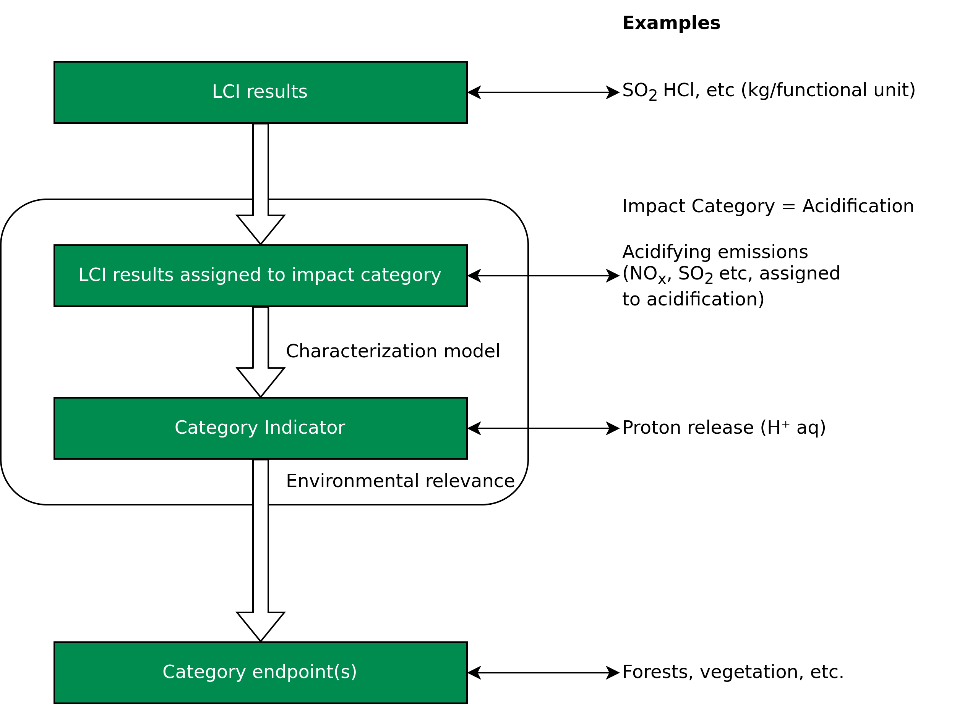
Lifecycle Impact Assessment (LCIA)
Oveview
Term | Example
Impact Category | Climate change
LCI results | Amount of a greenhouse gas per functional unit
Characterization model | Baseline model of 100 years of the Intergovernmental Panel on Climate Change
Category indicator | Infrared radiative forcing (W/m²)
Charecterization factor | Global warming potential (GWP100) for each greenhouse gas (kg CO2–equivalents/ kg of gas)
Category indicator result | Kilograms of CO2–equivalents per functional unit
Category endpoints | Coral reefs, forests, crops
Environmental relevance | Infrared radiative forcing is a proxy for potential effects on the climate, depending on the integrated atmospheric heat adsorption caused by emissions and the distribution over time of the heat adsorption.
ISO 14040 Environmental management — Life cycle assessment — Principles and framework, International standards organisation (https://www.iso.org/standard/37456.html)
Determining the environmental impacts of conventional and alternatively fuelled vehicles through LCA, Ricardo Energy and Environment (Link)

Slide 58
Lifecycle Impact Assessment (LCIA)
Oveview
ISO 14040 Environmental management — Life cycle assessment — Principles and framework, International standards organisation (https://www.iso.org/standard/37456.html)
Determining the environmental impacts of conventional and alternatively fuelled vehicles through LCA, Ricardo Energy and Environment (Link)

Slide 59
Lifecycle Impact Assessment (LCIA)
MushR Example
Impact category | Reference unit | Mushroom Substrate Bag | MushR Reusable Pods
Acidification | H+ mmole eq | 11.21 | 40.15
Global warming | g CO2 eq | 102.46 | 217.20
Ozone depletion | g CFC-11 eq | 2.64E-07 | 1.49E-06
Water intake | liters | 0.95 | 2.3
Tables recreated from Determining the environmental impacts of conventional and alternatively fuelled vehicles through LCA, Ricardo Energy and Environment (Link)

Slide 60
Lifecycle Impact Assessment (LCIA)
MushR Example
Impact category | Reference unit | Mushroom Substrate Bag | MushR Reusable Pods | MushR Pods Break-even point (reuse cycles)
Acidification | H+ mmole eq | 11.21 | 40.15 | 3.6
Global warming | g CO2 eq | 102.46 | 217.20 | 2.1
Ozone depletion | g CFC-11 eq | 2.64E-07 | 1.49E-06 | 5.6
Water intake | liters | 0.95 | 2.3 | 2.4
Tables recreated from Determining the environmental impacts of conventional and alternatively fuelled vehicles through LCA, Ricardo Energy and Environment (Link)

Slide 61
Lifecycle Impact Assessment (LCIA)
2020 EU Study Example
Impact Category | Indicator and unit
Climate change | Greenhouse gas emissions GWP100 in CO2 eq (including carbon feedbacks)
Energy consumption | Cumulative energy demand in MJ: non-renewable (fossil and nuclear) and renewable
Acidification | Acidification potential in SO2 eq
Eutrophication | Eutrophication potential in PO4³⁻ eq
Photochemical ozone formation | Photochemical Ozone Creation Potential POCP in NMVOC eq
Ozone depletion | ODP in R11 eq
Ionising radiation | Ionising radiation potentials in U235 eq
Particulate matter | Particulate matter formation in PM2.5 eq
Human toxicity, cancer and non-cancer | Comparative Toxic Unit for Human Health in CTUh
Ecotoxicity, freshwater | Comparative Toxic Unit for ecosystems in CTUe
Resource depletion – minerals and metals | ADP ultimate reserves in Sb eq
Resource depletion – fossil energy carriers | ADP fossil in MJ
Land use | Land occupation in m² * a
Water scarcity | Scarcity-adjusted water use in m³
Pollutant | Acidification | Eutrophication | POCP | Particulate matter formation (PMF)
CO | 0 | 0 | 0.0456 | 0
NH3 | 1.6 | 0.35 | 0 | 0.64
NOx | 0.5 | 0.13 | 1 | 0.88
PM2.5 | 0 | 0 | 0 | 1
SOx | 1 | 0 | 0.0811 | 0.54
NMVOC | 0 | 0 | 1 | 0.012
Non-methane volatile organic compoind
Tables recreated from Determining the environmental impacts of conventional and alternatively fuelled vehicles through LCA, Ricardo Energy and Environment (Link)

Slide 62
Lifecycle Impact Assessment (LCIA)
2020 EU Study Example
Chart adapted from Determining the environmental impacts of conventional and alternatively fuelled vehicles through LCA, Ricardo Energy and Environment (Link)

Slide 63
Lifecycle Interpretation
Definition
Lifecycle Interpretatopm is the phase of life cycle assessment in which the findings of either the inventory analysis or the impact assessment, or both, are evaluated in relation to the defined goal and scope in order to reach conclusions and recommendations.
ISO 14040 Environmental management — Life cycle assessment — Principles and framework, International standards organisation (https://www.iso.org/standard/37456.html)
Determining the environmental impacts of conventional and alternatively fuelled vehicles through LCA, Ricardo Energy and Environment (Link)

Slide 64
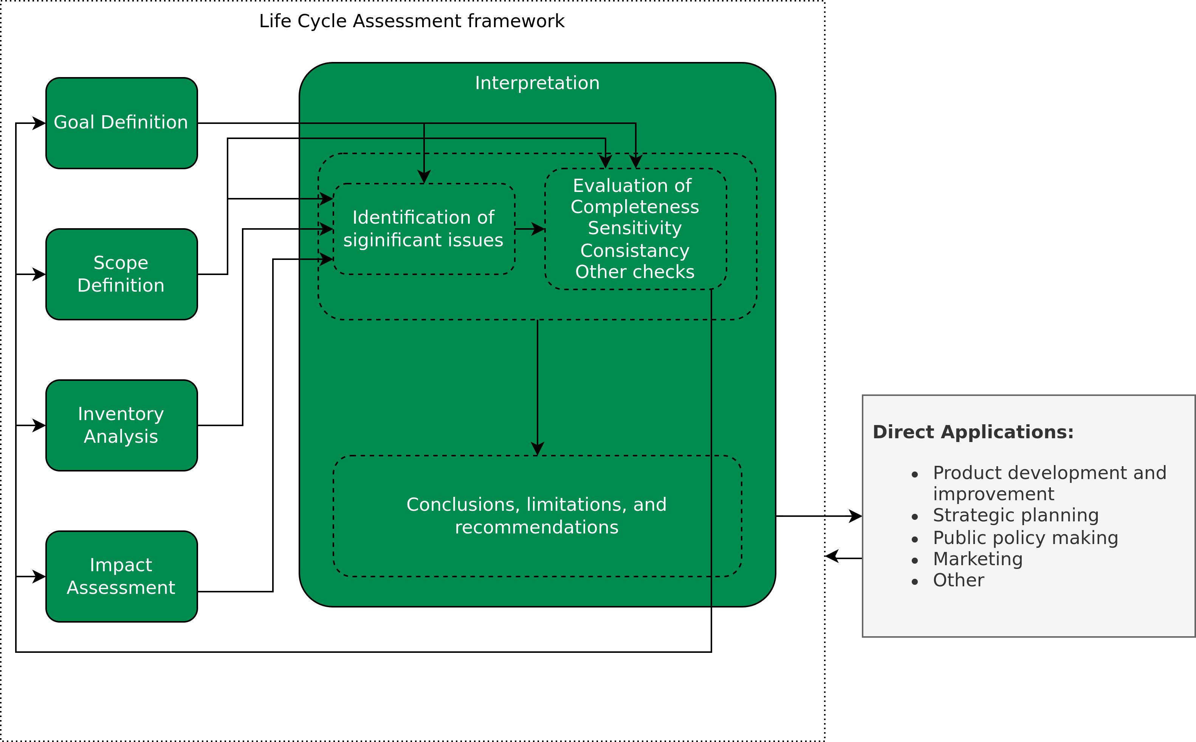
Lifecycle Interpretation
Overview
Image adapted from ISO 14040 Environmental management — Life cycle assessment — Principles and framework, International standards organisation (https://www.iso.org/standard/37456.html)
Determining the environmental impacts of conventional and alternatively fuelled vehicles through LCA, Ricardo Energy and Environment (Link)

Slide 65
Lifecycle Interpretation
Identification of significant issues
Two interrelated aspects of significant issues:
The main contributors to environmental impacts, like most important lifecycle stages, processes and elementary flows.
Image adapted from ISO 14040 Environmental management — Life cycle assessment — Principles and framework, International standards organisation (https://www.iso.org/standard/37456.html)
Determining the environmental impacts of conventional and alternatively fuelled vehicles through LCA, Ricardo Energy and Environment (Link)

Slide 66
Lifecycle Interpretation
Identification of significant issues
Two interrelated aspects of significant issues:
The main contributors to environmental impacts, like most important lifecycle stages, processes and elementary flows.
The main choices that have the potential to influence the precision of the final results of the LCA, like methodological choices (e.g., cut-offs), assumptions, data, LCIA methods.
Image adapted from ISO 14040 Environmental management — Life cycle assessment — Principles and framework, International standards organisation (https://www.iso.org/standard/37456.html)
Determining the environmental impacts of conventional and alternatively fuelled vehicles through LCA, Ricardo Energy and Environment (Link)

Slide 67
Lifecycle Interpretation
Evaluation
Evaluation is performed to establish the foundation for subsequently drawing the conclusions and provide reccommendations during the interpretation of the study results.
ILCD Handbook – General guide for Life Cycle Assessment – Detailed Guidance (Link)

Slide 68
Lifecycle Interpretation
Evaluation
Evaluation is performed to establish the foundation for subsequently drawing the conclusions and provide reccommendations during the interpretation of the study results.
This involves:
Completeness checks
Sensitivity checks in combination with scenario analysis and potentially uncertainity analysis
Consistancy checks
ILCD Handbook – General guide for Life Cycle Assessment – Detailed Guidance (Link)

Slide 69
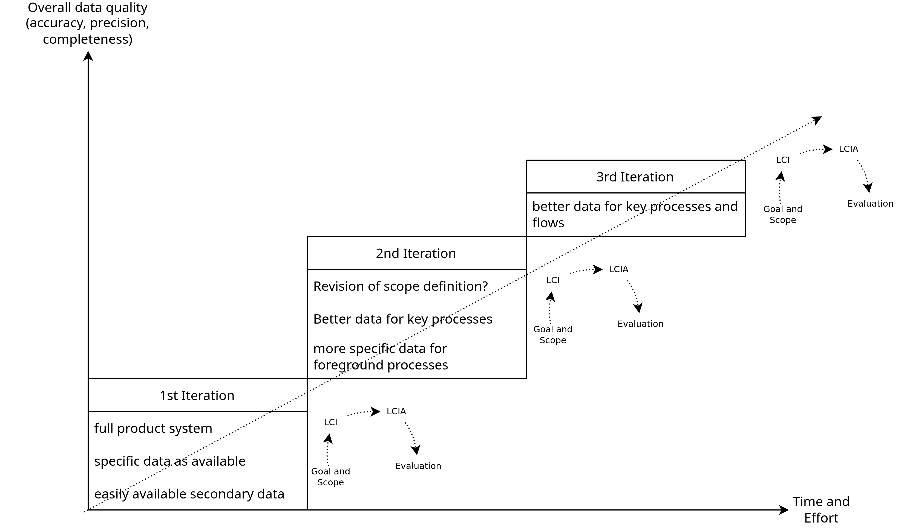
Iterative Approach to LCA
ILCD Handbook – General guide for Life Cycle Assessment – Detailed Guidance (Link)

Slide 70
Reporting and Critical Review
A reporting strategy is an integral part of an LCA.
A report should:
contain the results and conclusions of the LCA in an adequate form to the intended audience
address the data, methods and assumptions applied in the study, and the limitations thereof.
ISO 14040 Environmental management — Life cycle assessment — Principles and framework, International standards organisation (https://www.iso.org/standard/37456.html)

Slide 71
Reporting and Critical Review
A reporting strategy is an integral part of an LCA.
A report should:
contain the results and conclusions of the LCA in an adequate form to the intended audience
address the data, methods and assumptions applied in the study, and the limitations thereof.
A critical review will fascilitate understanding and enhance the credibility of the LCA.
Critical reviews verify whether the LCA has met the requirements for methodology, data, interpretation and reporting and whether it is consistant with it’s principles.
Carried out by an internal or external expert, or by a panel of interested parties.
ISO 14040 Environmental management — Life cycle assessment — Principles and framework, International standards organisation (https://www.iso.org/standard/37456.html)

Slide 72
Conclusion

Slide 73
Conclusion
A high-level overview and guide to Life Cycle Assessment
Goal and Scope definition
Life Cycle Inventory analysis
Unit Processes and Process flows
Life Cycle Impact Assessment
Impact categories, classification, characterization, weighting, etc.
Life Cycle Interpretation
Evaluation
Reporting and Critical review
Examples from Polestar, 2020 EU Commission report, MushR project

Slide 74
Exercise 3 - LCA

Slide 75
Exercise 3 - LCA
Main Goal: Compare the water consumption of washing dishes: manually using a sink vs a dishwasher, to determine which consumes less.
Simplistic assumption: A dishwasher at full load requires ~11 litres of water to perfectly clean 20 dishes, 20 glasses and 20 pieces of cutlery. We do this to obtain comparative results.
Main Task: To collect LCI data, and determine “How much water do you consume to perfectly clean 20 dishes, 20 glasses and 20 pieces of cutlery?”
Functional Unit: ?

Slide 76
Exercise 3 - LCA
Main Goal: Compare the water consumption of washing dishes: manually using a sink vs a dishwasher, to determine which consumes less.
Simplistic assumption: A dishwasher at full load requires ~11 litres of water to perfectly clean 20 dishes, 20 glasses and 20 pieces of cutlery. We do this to obtain comparative results.
Main Task: To collect LCI data, and determine “How much water do you consume to perfectly clean 20 dishes, 20 glasses and 20 pieces of cutlery?”
Functional Unit: 20 dishes, 20 glasses and 20 pieces of cutlery cleaned.
Reference Flow: ?

Slide 77
Exercise 3 - LCA
Main Goal: Compare the water consumption of washing dishes: manually using a sink vs a dishwasher, to determine which consumes less.
Simplistic assumption: A dishwasher at full load requires ~11 litres of water to perfectly clean 20 dishes, 20 glasses and 20 pieces of cutlery. We do this to obtain comparative results.
Main Task: To collect LCI data, and determine “How much water do you consume to perfectly clean 20 dishes, 20 glasses and 20 pieces of cutlery?”
Functional Unit: 20 dishes, 20 glasses and 20 pieces of cutlery cleaned.
Reference Flow: Amount of water consumed (in Liters)

Slide 78
Exercise 3 - LCA
Main Goal: Compare the water consumption of washing dishes: manually using a sink vs a dishwasher, to determine which consumes less.
Simplistic assumption: A dishwasher at full load requires ~11 litres of water to perfectly clean 20 dishes, 20 glasses and 20 pieces of cutlery. We do this to obtain comparative results.
Main Task: To collect LCI data, and determine “How much water do you consume to perfectly clean 20 dishes, 20 glasses and 20 pieces of cutlery?”
Functional Unit: 20 dishes, 20 glasses and 20 pieces of cutlery cleaned.
Reference Flow: Amount of water consumed (in Liters)
Full description and instructions of the task in the Exercise sheet.

Slide 79
Questions?

